Slide 1
DIABETES MELLITUS
PROF. JOEL SOLORZANO

Slide 2
Diabetes mellitus (DM) The term diabetes mellitus describes a metabolic disorder of multiple aetiology characterized by chronic hyperglycaemia with disturbances of carbohydrate, fat and protein metabolism resulting from defects in insulin secretion, insulin action, or both.

Slide 3


Slide 4
Burden of Diabetes
The development of diabetes is projected to reach pandemic proportions over the next10-20 years.
International Diabetes Federation (IDF) data indicate that by the year 2025, the number of people affected will reach 333 million –90% of these people will have Type 2 diabetes.
In most Western societies, the overall prevalence has reached 4-6%, and is as high as 10-12% among 60-70-year-old people.
The annual health costs caused by diabetes and its complications account for around 6-12% of all health-care expenditure.

Slide 5
2.
Classification
and
Diagnosis of Diabetes
Notes:
Moving on to section two, Classification and Diagnosis of Diabetes….
[SLIDE]
5

Slide 6
Classification & Diagnosis
Classification
Diagnostic Tests for Diabetes
Prediabetes
Type 1 Diabetes
Type 2 Diabetes
Gestational Diabetes
Monogenic Diabetes Syndromes
Cystic Fibrosis-Related Diabetes
American Diabetes Association Standards of Medical Care in Diabetes.
Classification and diagnosis of diabetes. Diabetes Care 2017; 40 (Suppl. 1): S11-S24
Notes:
This section includes several key areas, such as classification of and diagnostic tests for diabetes, prediabetes, type 1 and type 2 diabetes, GDM, MODY, and CFRD, or Cystic Fibrosis-Related Diabetes.
[SLIDE]
6

Slide 7
Classification of Diabetes
Type 1 diabetes
  β-cell destruction
Type 2 diabetes
  Progressive insulin secretory defect
Gestational Diabetes Mellitus (GDM)
Other specific types of diabetes
  Monogenic diabetes syndromes
  Diseases of the exocrine pancreas, e.g., cystic fibrosis
  Drug- or chemical-induced diabetes
American Diabetes Association Standards of Medical Care in Diabetes.
Classification and diagnosis of diabetes. Diabetes Care 2017; 40 (Suppl. 1): S11-S24
Notes:
The classification of diabetes includes four clinical categories:
Type 1 diabetes, due to β-cell destruction, usually leading to absolute insulin deficiency; [CLICK]
Type 2 diabetes, due to a progressive insulin secretory defect on the background of insulin resistance; [CLICK]
Gestational diabetes mellitus, which is diabetes diagnosed during pregnancy that is not clearly overt diabetes [CLICK]
Other specific types of diabetes due to other causes; e.g., genetic defects in β-cell function, genetic defects in insulin action, diseases of the exocrine pancreas (such as cystic fibrosis), and drug- or chemical-induced diabetes (such as in the treatment of HIV/AIDS or after organ transplantation)
[SLIDE]
7
Reference
American Diabetes Association. Standards of medical care in diabetes—2014. Diabetes Care 2014;37(suppl 1):S14

Slide 8
Secondary DM
Secondary causes of Diabetes mellitus include:
Acromegaly,
Cushing syndrome,
Thyrotoxicosis,
Pheochromocytoma
Chronic pancreatitis,
Cancer
Drug induced hyperglycemia:
  Atypical Antipsychotics - Alter receptor binding characteristics, leading to increased insulin resistance.
  Beta-blockers - Inhibit insulin secretion.
  Calcium Channel Blockers - Inhibits secretion of insulin by interfering with cytosolic calcium release.
  Corticosteroids - Cause peripheral insulin resistance and gluconeogensis.
  Fluoroquinolones - Inhibits insulin secretion by blocking ATP sensitive potassium channels.
  Naicin - They cause increased insulin resistance due to increased free fatty acid mobilization.
  Phenothiazines - Inhibit insulin secretion.
  Protease Inhibitors - Inhibit the conversion of proinsulin to insulin.
  Thiazide Diuretics - Inhibit insulin secretion due to hypokalemia. They also cause increased insulin resistance due to increased free fatty acid mobilization.

Slide 9
Classic diabetes symptoms
POLIURIA
POLIDIPSIA
POLIPHAGIA

Slide 10
Comparisons of Type 1 & Type 2
Type 1 (5-10%)
Sudden onset
Severe symptoms
Weight loss
Lean
Ketosis
Absent C-peptides
Markers of autoimmunity present
Family history uncommon
Onset usually in the young
Type 2 (90-95%)
Gradual onset
May be Asymptomatic
Often no weight loss
Usually obese
Not ketotic
C-peptide detectable
No markers of autoimmunity present
Family history
Onset usually >40 years old
Notes:
Insulin resistance is a characteristic feature of both obesity and diabetes - there are fewer insulin receptors as well as there being faults potentially with the receptors so the body is not able to respond adequately
Insulin resistance is thought to be caused by both genetic factors and lifestyle. Modern lifestyles with rich diets and little exercise have been linked to insulin resistance and Type 2 diabetes. An increase in body weight can trigger insulin resistance in people who are genetically prone to the condition. More than 25 % of people worldwide are estimated to be insulin resistant, although this does not mean that they have diabetes.
Insulin resistance is also linked to other conditions, such as high blood pressure and cholesterol problems, which can lead to heart and circulation problems. This may be why people with Type 2 diabetes are more likely to suffer from heart disease or stroke. In fact, heart disease is the most common cause of death amongst people with Type 2 diabetes.
Syndrome X is a cluster of features such as glucose intolerance, obesity, hypertension, accelerated atherosclerosis,low HDL and high triglycerides and VLDL. Other abnormalities are increased clotting due to increased levels of fibrinogen.

Slide 11
Criteria for the Diagnosis of Diabetes
Fasting plasma glucose (FPG) ≥126 mg/dL (7.0 mmol/L)
OR
2-h plasma glucose ≥200 mg/dL (11.1 mmol/L) during an OGTT
OR
A1C ≥6.5%
OR
Classic diabetes symptoms + random plasma glucose ≥200 mg/dL (11.1 mmol/L)
American Diabetes Association Standards of Medical Care in Diabetes.
Classification and diagnosis of diabetes. Diabetes Care 2017; 40 (Suppl. 1): S11-S24
Notes:
Fasting plasma glucose, the 2 hour plasma glucose after a 75-g oral glucose tolerance test, and A1C are equally appropriate diagnostic tests for diabetes.
These diagnostic criteria are:
Fasting plasma glucose (FPG) ≥126 mg/dL
OR
2-hour plasma glucose ≥200 mg/dL during an OGTT
OR
A1C ≥6.5%
Or in a patient with classic symptoms of hyperglycemia a random plasma glucose ≥ 200 can also be used.
In the absence of unequivocal hyperglycemia, the result should be confirmed by repeat testing.
[SLIDE]
11
Reference
American Diabetes Association. Standards of medical care in diabetes—2014. Diabetes Care 2014;37(suppl 1):S15; Table 2

Slide 12
Glucose Tolerance Test
3 days of unrestricted diet and exercise
Evening meal as normal the night before
Overnight fast of 8-14 hours
TEST
Fasting blood on the morning
Drink 75g of anhydrous glucose in 250-300ml water over 5 mins
Blood sample 2 hours later
No smoking during the test
Notes:
Oral glucose tolerance tests should be used on all individuals that have an impaired fasting glucose – where blood glucose levels are above the norm but below the diagnostic criteria for diabetes. The DECODE study found that these individuals along with Impaired Glucose tolerance subjects were at much greater risk of developing diabetes as well as cardiovascular disease.
The difference between IFT and IGT is that one is done fasting the other is done post prandially (ie after a meal and when CHO load at its peak)
Many people with Type 2 may have been walking around with undiagnosed diabetes and evidence suggests that on average it takes 10 years to present with a decline of 4% pancreatic function every year and thereafter diagnosis.

Slide 13
DIAGNOSIS AFTER AN OGTT
 | Impaired Fasting Glucose (IFG) | Impaired Glucose Tolerance (IGT) | Diabetes
Fasting Venous Plasma Glucose | 6.1 mmol/l to 6.9 mmol/l | <7.0 mmol/l | > 7.0 mmol/l
2 hr post | < 7.8 mmo/l | >7.8 mmol/l up to 11.1 mmol/l | >11.1 mmol/l (WHO,2006)

Slide 14
Impaired Glucose Regulation
Impaired Glucose Tolerance (IGT)
- Abnormalities in glucose regulation in the post-prandial state.
- More common in women
Impaired Fasting Glucose (IFG)
  - Elevated fasting glucose concentrations, but lower than those required to diagnose diabetes
  - More common in men

Slide 15
Impaired Glucose Regulation
IFG and IGT are not interchangeable.
Both can lead to diabetes or revert to normoglycaemia
Both are associated with an increased risk of Cardiovascular disease
Identify & Read Code
Adhere to local guidelines regarding follow up

Slide 16
HbA1c Criteria
Recently agreed by WHO & Diabetes UK
Provides positive identification (ie specific)
- If Hba1c > 48mmol/mol, twice or once in prescence of osmotic symptoms, and…
- if no confounding clinical problems
Fails to rule out normality
- Hba1c <48mmol/mol does not rule out diabetes
- glucose criteria then remain essential
Algorithm not widely agreed. Awaiting WEDS approval.

Slide 17
HbA1c > 48mmol/mol
Asymptomatic
Repeat within 2 weeks
Symptomatic
HbA1c > 48mmol/mol
Type 2 Diabetes Diagnosed

Slide 18
HbA1c < 47mmol/mol
Does not exclude Diabetes
Hba1c 42 –47mmol/mol
Symptoms present exclude diabetes using conventional glucose tests
Lifestyle changes & monitor at least annually

Slide 19
Recommendations: Type 1 Diabetes
Blood glucose rather than A1C should be used to dx type 1 diabetes in symptomatic individuals. E
Screening for type 1 diabetes with an antibody panel is recommended only in the setting of a clinical research study or in a first-degree family members of a proband with type 1 diabetes. B
www.DiabetesTrialNet.org
American Diabetes Association Standards of Medical Care in Diabetes.
Classification and diagnosis of diabetes. Diabetes Care 2017; 40 (Suppl. 1): S11-S24
Notes:
Moving on to type 1 diabetes diagnosis and screening recommendations, these patients often present with acute symptoms of diabetes and markedly elevated blood glucose levels, and some cases are diagnosed with life-threatening ketoacidosis.
In these cases, knowing the blood glucose level is critical because, in addition to confirming that symptoms are due to diabetes mellitus, this will inform management decisions. Some providers may also want to know the A1C to determine how long a patient has had hyperglycemia. Therefore the Association recommends that blood glucose rather than A1c should be used to diagnose acute onset type 1 diabetes in those with symptoms of hyperglycemia. [CLICK]
While there is currently a lack of accepted screening programs, consider referring relatives of those with type 1 diabetes for antibody testing for risk assessment in the setting of a clinical research study, which can be identified at diabetestrialnet.org. Persistence of two or more autoantibodies predicts clinical diabetes and may serve as an indication for intervention in the setting of a clinical trial.
[SLIDE]
19
References
American Diabetes Association. Standards of medical care in diabetes—2014. Diabetes Care 2014;37(suppl 1):S18
Imperatore G, Boyle JP, Thompson TJ, et al.; SEARCH for Diabetes in Youth Study Group. Projections of type 1 and type 2 diabetes burden in the U.S. population aged <20 years through 2050: dynamic modeling of incidence, mortality, and population growth. Diabetes Care 2012;35:2515–2520
Lipman TH, Levitt Katz LE, Ratcliffe SJ, et al. Increasing incidence of type 1 diabetes in youth: twenty years of the Philadelphia Pediatric Diabetes Registry. Diabetes Care 2013;36:1597–1603
Pettitt DJ, Talton J, Dabelea D, et al. Prevalence of diabetes mellitus in U.S. youth in 2009: the SEARCH for Diabetes in Youth Study. Diabetes Care. 16 September 2013 [Epub ahead of print]

Slide 20
Prediabetes: Impaired glucose tolerance and impaired fasting glucose
Prediabetes is a term used to distinguish people who are at increased risk of developing diabetes. People with prediabetes have impaired fasting glucose (IFG) or impaired glucose tolerance (IGT). Some people may have both IFG and IGT.
IFG is a condition in which the fasting blood sugar level is elevated (100 to 125 milligrams per decilitre or mg/dL) after an overnight fast but is not high enough to be classified as diabetes.
IGT is a condition in which the blood sugar level is elevated (140 to 199 mg/dL after a 2-hour oral glucose tolerance test), but is not high enough to be classified as diabetes.

Slide 21
Recommendations: Prediabetes
Screening for prediabetes with an informal assessment of risk factors or validated tools should be considered in asymptomatic adults. B
Testing should begin at age 45 for all people. B
Consider testing for prediabetes in asymptomatic adults of any age w/ BMI ≥25 kg/m2 or ≥23 kg/m2 (in Asian Americans) who have 1 or more add’l risk factors for diabetes. B
If tests are normal, repeat at a minimum of 3-year intervals. C
American Diabetes Association Standards of Medical Care in Diabetes.
Classification and diagnosis of diabetes. Diabetes Care 2017; 40 (Suppl. 1): S11-S24
Notes:
Screening for prediabetes with an informal assessment of risk factors or validated tools should be considered in asymptomatic adults. [CLICK]
The Association recommends testing all adults beginning at age 45 years, regardless of weight. [CLICK]
Testing is also recommended for asymptomatic adults of any age who are overweight or obese and who have one or more additional risk factors for diabetes. [CLICK] If tests are normal, the Association recommends repeat testing at least every 3 years.
[SLIDE]
21

Slide 22
Recommendations: Prediabetes (2)
FPG, 2-h PG after 75-g OGTT, and A1C, are equally appropriate for prediabetes testing. B
In patients with prediabetes, identify and, if appropriate, treat other CVD risk factors. B
Consider prediabetes testing in overweight/obese children and adolescents with 2 or more add’l diabetes risk factors. E
American Diabetes Association Standards of Medical Care in Diabetes.
Classification and diagnosis of diabetes. Diabetes Care 2017; 40 (Suppl. 1): S11-S24
Notes:
Any of the three tests we discussed a few slides ago– FPG, OGTT, or A1C-- are appropriate tests for prediabetes; [CLICK]
In your patients with prediabetes, do identify and treat other cardiovascular risk factors as appropriate. [CLICK]
And finally, consider prediabetes testing in overweight or obese children and adolescents when they have 2 or more additional risk factors.
[SLIDE]
22

Slide 23
Prediabetes*
FPG 100–125 mg/dL (5.6–6.9 mmol/L): IFG OR
2-h plasma glucose 140–199 mg/dL (7.8–11.0 mmol/L): IGT OR
A1C 5.7–6.4%
* For all three tests, risk is continuous, extending below the lower limit of a range and becoming disproportionately greater at higher ends of the range.
American Diabetes Association Standards of Medical Care in Diabetes.
Classification and diagnosis of diabetes. Diabetes Care 2017; 40 (Suppl. 1): S11-S24
Notes:
Here are the diagnostic cutpoints for prediabetes across the three tests. Note that risk is continuous, extending below the lower limit of a range and becoming disproportionately greater at higher ends of the range.
[SLIDE]
23
References
Expert Committee on the Diagnosis and Classification of Diabetes Mellitus. Report of the Expert Committee on the Diagnosis and Classification of Diabetes Mellitus. Diabetes Care 1997;20:1183–1197
Genuth S, Alberti KG, Bennett P, et al., for the Expert Committee on the Diagnosis and Classification of Diabetes Mellitus. Follow-up report on the diagnosis of diabetes mellitus. Diabetes Care 2003;26:3160–3167
American Diabetes Association. Standards of medical care in diabetes—2014. Diabetes Care 2014;37suppl 1):S16; Table 3

Slide 24
Recommendations: Testing for Type 2 Diabetes
Screening for type 2 diabetes with an informal assessment of risk factors or validated tools should be considered in asymptomatic adults. B
Consider testing in asymptomatic adults of any age with BMI ≥25 kg/m² or ≥23 kg/m² in Asian Americans who have 1 or more add’l dm risk factors. B
For all patients, testing should begin at age 45 years. B
If tests are normal, repeat testing carried out at a minimum of 3-year intervals is reasonable. C
American Diabetes Association Standards of Medical Care in Diabetes.
Classification and diagnosis of diabetes. Diabetes Care 2017; 40 (Suppl. 1): S11-S24
Notes:
Type 2 diabetes, previously referred to as “non-insulin-dependent diabetes” or “adult-onset diabetes,” accounts for 90–95% of all diabetes. This form encompasses individuals who have insulin resistance and usually relative (rather than absolute) insulin deficiency. At least initially, and often throughout their lifetime, patients with type 2 diabetes may not need insulin treatment to survive.
These recommendations look just like the screening recommendations for prediabetes, so we won’t spend more time on them.
[SLIDE]
24

Slide 25
Recommendations: Screening for Type 2 Diabetes (2)
FPG, 2-h PG after 75-g OGTT, and the A1C are equally appropriate. B
In patients with diabetes, identify and, if appropriate, treat other CVD risk factors. B
Consider testing for T2DM in overweight/obese children and adolescents with 2 or more add’l diabetes risk factors. E
American Diabetes Association Standards of Medical Care in Diabetes.
Classification and diagnosis of diabetes. Diabetes Care 2017; 40 (Suppl. 1): S11-S24
Notes:
And slide two of the screening recommendations for type 2 diabetes, again just like those for prediabetes.
[SLIDE]
25

Slide 26
Risk factors for Prediabetes and T2D
www.diabetes.org/are-you-at-risk
American Diabetes Association Standards of Medical Care in Diabetes.
Classification and diagnosis of diabetes. Diabetes Care 2017; 40 (Suppl. 1): S11-S24
Notes:
This slide shows the ADA’s list of risk factors for prediabetes and type 2 diabetes. If asymptomatic adults who are overweight or obese have one or more of the risk factors shown here, then they are candidates for testing for prediabetes and type 2 diabetes using the FPG, OGTT, or A1C test. Alternately, screening tools, such as ADA’s risk test, available at www.diabetes.org/are-you-at-risk can also identify patients who should be tested for prediabetes and type 2 diabetes.
[SLIDE]
26

Slide 27
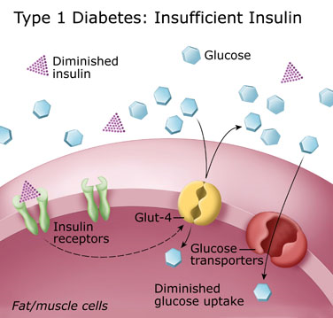
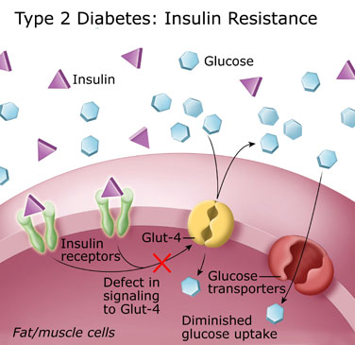

Slide 28
Staging of Type 1 Diabetes
American Diabetes Association Standards of Medical Care in Diabetes.
Classification and diagnosis of diabetes. Diabetes Care 2017; 40 (Suppl. 1): S11-S24
Notes:
Characterization of the underlying pathophysiology of diabetes is much more developed in type 1 diabetes than in type 2 diabetes. Three distinct stages of type 1 diabetes can be identified and serve as a framework for future research and regulatory decision making. The rate of progression is dependent on the age at first detection of antibody, number of antibodies, antibody specificity, and antibody titer. Glucose and A1C levels rise well before the clinical onset of diabetes, making diagnosis feasible well before the onset of DKA.
[SLIDE]
28
Reference
American Diabetes Association. Standards of medical care in diabetes—2014. Diabetes Care 2014;37(suppl 1):S14

Slide 29
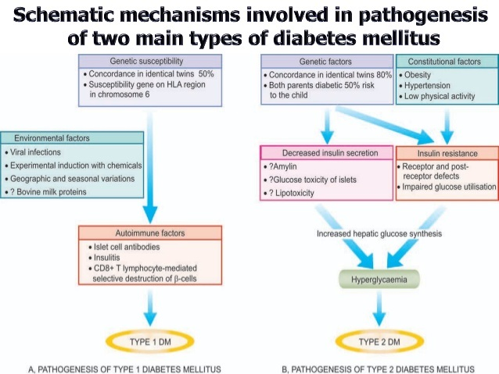

Slide 30
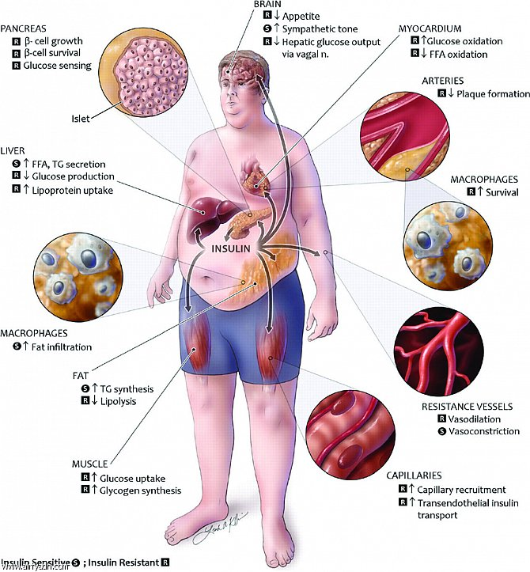

Slide 31
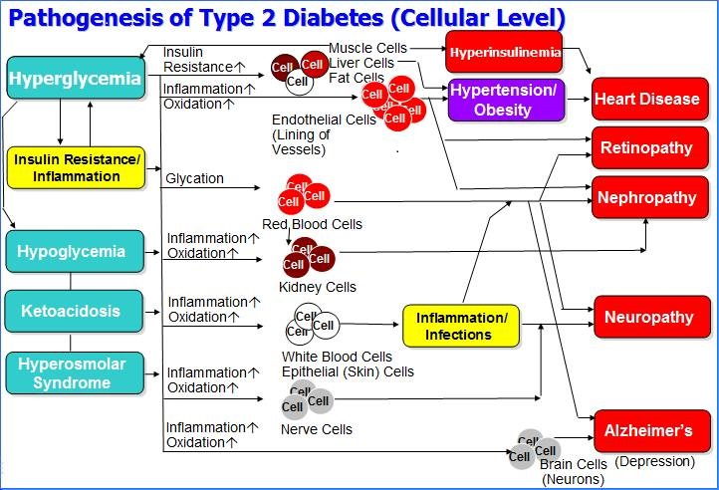

Slide 32
Complications of diabetes mellitus
Acute complications:
  Ketoacidosis
  The hyperglycemic hyperosmolar nonketotic syndrome
  Hypoglycemia
Chronic complications:
  Disorders of the microcirculation
    Neuropathies
    Nephropathies
    Retinopathies
  Macrovascular complications
  Infectious
  Foot ulcers

Slide 33
Hypoglycemia
Hypoglycemia occurs from a relative excess of insulin in the blood and is characterized by below-normal blood glucose levels.
It occurs most commonly in people treated with insulin injections, but prolonged hypoglycemia also can result from some oral hypoglycemic agents (i.e., beta cell stimulators).
Many factors precipitate an insulin reaction in a person with type 1 diabetes, including:
  Error in insulin dose
  Failure to eat
  Increased exercise
  Decreased insulin need after removal of a stress situation
  Medication changes and a change in insulin site
Alcohol decreases liver gluconeogenesis, and people with diabetes need to be cautioned about its potential for causing hypoglycemia.

Slide 34
The Somogyi effect
The Somogyi effect describes a cycle of insulin-induced posthypoglycemic episodes.
In people with diabetes, insulin-induced hypoglycemia produces a compensatory increase in blood levels of catecholamines, glucagon, cortisol, and growth hormone.
These counterregulatory hormones cause blood glucose to become elevated and produce some degree of insulin resistance.
The cycle begins when the increase in blood glucose and insulin resistance is treated with larger insulin doses.
The hypoglycemic episode often occurs during the night or at a time when it is not recognized, rendering the diagnosis of the phenomenon more difficult.
Measures to prevent this phenomena include a redistribution of dietary carbohydrates and an alteration in insulin dose or time of administration.

Slide 35
The dawn phenomenon
The dawn phenomenon is characterized by increased levels of fasting blood glucose or insulin requirements, or both, between 5 and 9 AM without preceding hypoglycemia.
It has been suggested that a change in the normal circadian rhythm for glucose tolerance, which usually is higher during the later part of the morning, is altered in people with diabetes. Growth hormone has been suggested as a possible factor.
When the dawn phenomenon occurs alone, it may produce only mild hyperglycemia, but when it is combined with the Somogyi effect, it may produce profound hyperglycemia.

Slide 36
Classification of diabetic peripheral neuropathies
Somatic:
  Polyneuropathies (bilateral sensory)
    Paresthesias, including numbness and tingling
    Impaired pain, temperature, light touch, two-point discrimination, and vibratory sensation
    Decreased ankle and knee-jerk reflexes
  Mononeuropathies
    Involvement of a mixed nerve trunk that includes loss of sensation, pain, and motor weakness.
  Amyotrophy
    Associated with muscle weakness, wasting, and severe pain of muscles in the pelvic girdle and thigh.
Autonomic:
  Impaired vasomotor function
    Postural hypotension
  Impaired gastrointestinal function
    Gastric atony
    Diarrhea, often postprandial and nocturnal
  Impaired genitourinary function
    Paralytic bladder
    Incomplete voiding
    Impotence
    Retrograde ejaculation
  Cranial nerve involvement
    Extraocular nerve paralysis
    Impaired pupillary responses
    Impaired special senses

Slide 37
Diabetic nephropathy
Diabetic nephropathy is the leading cause of end-stage renal disease, accounting for 40% of new cases.
The term diabetic nephropathy is used to describe the combination of lesions that often occur concurrently in the diabetic kidney. The most common kidney lesions in people with diabetes are those that affect the glomeruli.
Various glomerular changes may occur, including capillary basement membrane thickening, diThe exact cause of diabetic nephropathy is unknown, but various postulated mechanisms are:
Hyperglycemia (causing hyperfiltration and renal injury)
Advanced glycosylation products
Activation of cytokines
ffuse glomerular sclerosis, and nodular glomerulosclerosis.

Slide 38
Retinopathies
Diabetic retinopathy is characterized by abnormal retinal vascular permeability, microaneurysm formation, neovascularization and associated hemorrhage, scarring, and retinal detachment.
Among the suggested risk factors associated with diabetic retinopathy are poor glycemic control, elevated blood pressure, and hyperlipidemia.

Slide 39
Infections
Although not specifically an acute or a chronic complication, infections are a common concern of people with diabetes.
Certain types of infections occur with increased frequency in people with diabetes:
  Soft tissue infections of the extremities
  Osteomyelitis
  Urinary tract infections and pyelonephritis
  Candidal infections of the skin and mucous surfaces
  Dental caries and infections
  Tuberculosis

Slide 40
Comprehensive Medical Evaluation
A complete medical evaluation should be performed at the initial visit to:
Confirm & classify diagnosis B
Detect complications & potential comorbid
conditions E
Review prior treatment & risk factor control E
Begin formulation of care management plan B
Develop a continuing care plan B
American Diabetes Association Standards of Medical Care in Diabetes. Comprehensive Medical Evaluation and Assessment of Comorbidities. Diabetes Care 2017; 40 (Suppl. 1): S25-S32
Notes:
Moving on to the medical evaluation, a comprehensive medical evaluation should be performed at the initial visit in order to accomplish several things:
First, to confirm the diagnosis and classify diabetes; [CLICK]
To detect any potential diabetes complications and potential comorbid conditions; [CLICK]
In patients with established diabetes, to review previous treatment and risk factor control; [CLICK]
To Begin patient engagement in the formulation of a care management plan, and finally, [CLICK]
To develop a continuing care plan
[SLIDE[
40

Slide 41
Components of the Comprehensive Diabetes Evaluation
Medical history:
Age and characteristics of onset of diabetes
Eating patterns, nutritional status, weight history, sleep behaviors, physical activity habits, nutrition education
Presence of common comorbidities and dental disease
Screen for psychosocial problems and other barriers to self-management
History of tobacco use, alcohol consumption, and substance use
American Diabetes Association Standards of Medical Care in Diabetes. Comprehensive Medical Evaluation and Assessment of Comorbidities. Diabetes Care 2017; 40 (Suppl. 1): S25-S32
Notes:
A focus on the components of comprehensive diabetes evaluation will help ensure optimal management of the patient with diabetes. These are outlined on the next several slides. First, medical history, including age and characteristics of onset of diabetes; eating patterns, nutritional status, weight history, sleep behaviors—which is a new addition for 2017 based on research suggesting a link between sleep and glucose control--physical activity habits, nutrition education and behavioral support history and needs; presence of common comorbidities. Screening for psychosocial problems, including diabetes distress, depression, anxiety, and disordered eating, with validated and appropriate measures is recommended, as well as an assessment of other barriers to successful self care, including limited financial, logistical, or support resources. The use of tobacco, alcohol, and narcotics should also be assessed.
[SLIDE]
41
Reference
American Diabetes Association. Standards of medical care in diabetes—2014. Diabetes Care 2014;37(suppl 1):S21; Table 7

Slide 42
Components of the Comprehensive Diabetes Evaluation (2)
Medical History (2):
Diabetes education, self-management, and support
history & needs
Previous treatment regimens and response to therapy
(A1C records)
Results of glucose monitoring and patient’s use of data
DKA frequency, severity, and cause
Hypoglycemia episodes, awareness, frequency & causes
Assess medication-taking behaviors/barriers to adherence
American Diabetes Association Standards of Medical Care in Diabetes. Comprehensive Medical Evaluation and Assessment of Comorbidities. Diabetes Care 2017; 40 (Suppl. 1): S25-S32
Notes:
The medical history should also include the patient’s history of diabetes education, self-management, and support as well as their needs in each of these areas. Previous treatment regimens and response to therapy; results of glucose monitoring and the patient’s data use; frequency of diabetic ketoacidosis, severity and cause; and hypoglycemic episodes, awareness, frequency and causes. Assessing for medication-taking behaviors and barriers to medication adherence was also highlighted in the 2017 Standards as an important part of the comprehensive medical evaluation.
[SLIDE]
42
Reference
American Diabetes Association. Standards of medical care in diabetes—2014. Diabetes Care 2014;37(suppl 1):S21; Table 7

Slide 43
Components of the Comprehensive Diabetes Evaluation (3)
Medical History (3):
History of increased blood pressure, abnormal lipids
Microvascular: retinopathy, nephropathy, and neuropathy
(sensory, including history of foot lesions; autonomic,
including sexual dysfunction and gastroparesis)
Macrovascular: coronary heart disease, cerebrovascular
disease, and peripheral arterial disease
For women with childbearing capacity, review contraception and preconception planning
American Diabetes Association Standards of Medical Care in Diabetes. Comprehensive Medical Evaluation and Assessment of Comorbidities. Diabetes Care 2017; 40 (Suppl. 1): S25-S32
Notes:
And the final components of the medical history-- the patient’s history of high blood pressure, abnormal lipids; and any history of micro- or macrovascular complications, being certain to include sexual dysfunction. And for women of childbearing capacity, a review of contraception and preconception planning is strongly recommended.
[SLIDE]
43
Reference
American Diabetes Association. Standards of medical care in diabetes—2014. Diabetes Care 2014;37(suppl 1):S21; Table 7

Slide 44
Components of the Comprehensive Diabetes Evaluation (4)
Physical Examination:
Height, weight, and BMI; growth and pubertal development
in children and adolescents
Blood pressure determination, including orthostatic
measurements when indicated
Fundoscopic examination
Thyroid palpation
Skin examination
Comprehensive foot examination
American Diabetes Association Standards of Medical Care in Diabetes. Comprehensive Medical Evaluation and Assessment of Comorbidities. Diabetes Care 2017; 40 (Suppl. 1): S25-S32
Notes:
Moving on to the physical exam, which should include height, weight and BMI. In children and adolescents you should also track growth and pubertal development.
Blood pressure determination, an eye exam, thyroid palpation, skin exam– looking for acanthosis nigricans or injection or infusion sites; and the comprehensive foot exam, including inspection, palpation of dorsalis pedis and posterior tibial pulses, presence/absence of patellar and achilles reflexes, and determination of proprioception, vibration, and monofilament sensations.
[SLIDE]
44

Slide 45
Components of the Comprehensive Diabetes Evaluation (5)
Laboratory Evaluation
A1C, if results not available within past 3 months
If not performed/available within past year:
  Fasting lipid profile
  Liver function tests
  Spot urinary albumin-to-creatinine ratio
  Serum creatinine and eGFR
  Thyroid-stimulating hormone in patients with type 1 diabetes
American Diabetes Association Standards of Medical Care in Diabetes. Comprehensive Medical Evaluation and Assessment of Comorbidities. Diabetes Care 2017; 40 (Suppl. 1): S25-S32
Notes:
And finally, the last components of the comprehensive exam, the laboratory evaluation. Perform an A1C if results are not available from within the past 3 months. And the rest of these if you don’t have them from within the past year: a fasting lipid profile, liver function tests, spot urine albumin-to-creatinine ratio, serum creatinine and estimated glomerular filtration rate, and, finally, in patients with type 1, assess thyroid-stimulating hormone.
[SLIDE]
45

Slide 46
Common Comorbidities
Autoimmune Diseases (T1D)
Cancer
Cognitive Impairment Dementia
Fatty Liver Disease
Fractures
Hearing Impairment
HIV
Low Testosterone (Men)
Obstructive Sleep Apnea
Periodontal Disease
Psychosocial Disorders
American Diabetes Association Standards of Medical Care in Diabetes. Comprehensive Medical Evaluation and Assessment of Comorbidities. Diabetes Care 2017; 40 (Suppl. 1): S25-S32
Notes:
Moving on now to a discussion of the common comorbidities of diabetes, listed on this slide. We’ll highlight a few ADA recommendations relating to these comorbidities.
[SLIDE[
46

Slide 47
Recommendation: Autoimmune Disease
Consider screening patients with type 1 diabetes for autoimmune thyroid disease and celiac disease soon after diagnosis. E
American Diabetes Association Standards of Medical Care in Diabetes. Comprehensive Medical Evaluation and Assessment of Comorbidities. Diabetes Care 2017; 40 (Suppl. 1): S25-S32
Notes:
[SLIDE[
47

Slide 48
Management of DM
The major components of the treatment of diabetes are:
A
Diet and Exercise
B
Oral hypoglycaemic therapy
C
Insulin Therapy

Slide 49
Lifestyle
Management
Notes:
This section, previously entitled “Foundations of Care and Comprehensive Medical Evaluation,” was refocused on lifestyle management.
[SLIDE]
49

Slide 50


Slide 51
Goals of Nutrition Therapy
Promote & support healthful eating patterns, emphasizing a variety of nutrient-dense foods in appropriate portion sizes, to improve health and to:
  Achieve and maintain body weight goals
  Attain individualized glycemic, blood pressure, and lipid goals
  Delay or prevent complications of diabetes
Address nutrition needs based on personal & cultural preferences, health literacy & numeracy, access to healthful foods, willingness and ability to make behavioral changes & barriers to change.
American Diabetes Association Standards of Medical Care in Diabetes.
Lifestyle Management. Diabetes Care 2017; 40 (Suppl. 1): S33-43
Notes:
Figuring out what to eat can be the most challenging part of daily self-management for people with diabetes. The Association has long held that there is no “one size fits all” approach to nutrition therapy, and lays out four goals for nutrition therapy for adults with diabetes:
1. We want to promote and support healthful eating patterns, emphasizing a variety of nutrient-dense foods in appropriate portion sizes, in order to improve overall health and specifically to:
Achieve and maintain body weight goals
Attain individualized glycemic, blood pressure, and lipid goals
Delay or prevent complications of diabetes [CLICK]
To address individual nutrition needs based on personal and cultural preferences, health literacy and numeracy, access to healthful foods, willingness and ability to make behavioral changes, and barriers to change.
[SLIDE]
51

Slide 52
Goals of Nutrition Therapy (2)
To maintain the pleasure of eating by providing non-judgmental messages about food choices.
Provide practical tools for developing healthful eating patterns rather than focusing on individual macronutrients, micro-nutrients, or single foods.
American Diabetes Association Standards of Medical Care in Diabetes.
Lifestyle Management. Diabetes Care 2017; 40 (Suppl. 1): S33-43
Notes:
Third, we want to help our patients maintain the pleasure of eating by providing non-judgmental messages about food choices, and finally, [CLICK] we want to provide the individual with diabetes with practical tools for developing healthful eating patterns rather than focusing on individual macronutrients, micro-nutrients, or single foods.
[SLIDE}
52

Slide 53
A. Diet (cont.)
The following principles are recommended as dietary guidelines for people with diabetes:
Dietary fat should provide 25-35% of total intake of calories but saturated fat intake should not exceed 10% of total energy. Cholesterol consumption should be restricted and limited to 300 mg or less daily.
Protein intake can range between 10-15% total energy (0.8-1 g/kg of desirable body weight). Requirements increase for children and during pregnancy. Protein should be derived from both animal and vegetable sources.
Carbohydrates provide 50-60% of total caloric content of the diet. Carbohydrates should be complex and high in fibre.
Excessive salt intake is to be avoided. It should be particularly restricted in people with hypertension and those with nephropathy.

Slide 54
Recommendations: Physical Activity (1)
Most adults with type 1 C and type 2 B diabetes: 150+ min/wk of moderate-to-vigorous activity over at least 3 days/week with no more than 2 consecutive days without exercise. Shorter durations (minimum 75 min/week) of vigorous-intensity or interval training may be sufficient for younger and more physically fit individuals.
Adults with type 1 C and type 2 B diabetes should perform resistance training in 2-3 sessions/week on nonconsecutive days
American Diabetes Association Standards of Medical Care in Diabetes.
Lifestyle Management. Diabetes Care 2017; 40 (Suppl. 1): S33-43
Notes:
Recommendations for physical activity for people with diabetes are summarized on this slide and the next.
• Children with diabetes/prediabetes: at least 60 min/day physical activity [Click]
Most adults with type 1 and type 2 diabetes: 150+ min/wk of moderate-to-vigorous activity over at least 3 days/week with no more than 2 consecutive days without exercise. Shorter durations (minimum 75 min/week) of vigorous-intensity or interval training may be sufficient for younger and more physically fit individuals. [CLICK]
Adults with type 1 and type 2 diabetes should perform resistance training in 2-3 sessions/week on nonconsecutive days
[SLIDE]
54
References
American Diabetes Association. Standards of medical care in diabetes—2014. Diabetes Care 2014;37(suppl 1):S31
Knowler WC, Barrett-Connor E, Fowler SE, et al, for the Diabetes Prevention Program Research Group. Reduction in the incidence of type 2 diabetes with lifestyle intervention or metformin. N Engl J Med 2002;346:393–403
Tuomilehto J, Lindström J, Eriksson JG, et al.; Finnish Diabetes Prevention Study Group. Prevention of type 2 diabetes mellitus by changes in lifestyle among subjects with impaired glucose tolerance. N Engl J Med 2001;344:1343–1350
Pan XR, Li GW, Hu YH, et al. Effects of diet and exercise in preventing NIDDM in people with impaired glucose tolerance. The Da Qing IGT and Diabetes Study. Diabetes Care 1997;20:537–544
Colberg SR, Sigal RJ, Fernhall B, et al. Exercise and type 2 diabetes. The American Collegoe of Sports Medicine and the American Diabetes Association: joint position statement. Diabetes Care 2010;33:2692–2696

Slide 55
Recommendations: Physical Activity (2)
All adults, and particularly those with type 2 diabetes, should decrease the amount of time spent in daily sedentary behavior. B Prolonged sitting should be interrupted every 30 min for blood glucose benefits, particularly in adults with type 2 diabetes. C
Flexibility training and balance training are recommended 2–3 times/week for older adults with diabetes. Yoga and tai chi may be included based on individual preferences to increase flexibility, muscular strength, and balance. C
American Diabetes Association Standards of Medical Care in Diabetes.
Lifestyle Management. Diabetes Care 2017; 40 (Suppl. 1): S33-43
Notes:
Here are a couple new recommendations for 2017 [CLICK]
All adults, and particularly those with type 2 diabetes, should decrease the amount of time spent in daily sedentary behavior. Prolonged sitting should be interrupted every 30 min for blood glucose benefits, particularly in adults with type 2 diabetes. [CLICK]
New recommendation for 2017: Flexibility training and balance training are recommended 2–3 times/week for older adults with diabetes. Yoga and tai chi may be included based on individual preferences to increase flexibility, muscular strength, and balance.
[SLIDE]
55
References
American Diabetes Association. Standards of medical care in diabetes—2014. Diabetes Care 2014;37(suppl 1):S31
Knowler WC, Barrett-Connor E, Fowler SE, et al, for the Diabetes Prevention Program Research Group. Reduction in the incidence of type 2 diabetes with lifestyle intervention or metformin. N Engl J Med 2002;346:393–403
Tuomilehto J, Lindström J, Eriksson JG, et al.; Finnish Diabetes Prevention Study Group. Prevention of type 2 diabetes mellitus by changes in lifestyle among subjects with impaired glucose tolerance. N Engl J Med 2001;344:1343–1350
Pan XR, Li GW, Hu YH, et al. Effects of diet and exercise in preventing NIDDM in people with impaired glucose tolerance. The Da Qing IGT and Diabetes Study. Diabetes Care 1997;20:537–544
Colberg SR, Sigal RJ, Fernhall B, et al. Exercise and type 2 diabetes. The American Collegoe of Sports Medicine and the American Diabetes Association: joint position statement. Diabetes Care 2010;33:2692–2696

Slide 56
Recommendations: Smoking Cessation
Advise all patients not to use cigarettes, other tobacco products A or e-cigarettes E.
Include smoking cessation counseling and other forms of treatment as a routine component of diabetes care. B
American Diabetes Association Standards of Medical Care in Diabetes.
Lifestyle Management. Diabetes Care 2017; 40 (Suppl. 1): S33-43
Notes:
The Association offers two key recommendations in the areas of tobacco and e-cigarettes. First, do advise all patients not to use cigarettes, other tobacco products, or e-cigarettes. This last one – e-cigarettes– is hard, but there just are no rigorous studies demonstrating that e-cigarettes are a healthier alternative to smoking or that e-cigarettes can facilitate smoking cessation. More extensive research of their short- and long-term effects is needed to determine their safety and their cardiopulmonary effects in comparison with smoking and standard approaches to smoking cessation so the Association recommends against their use. [CLICK]
And secondly, do include smoking cessation counseling and other forms of treatment as a routine component of diabetes care.
[SLIDE]
56

Slide 57
Recommendations: Psychosocial Care
Psychosocial care should be provided to all people with diabetes, with the goals of optimizing health outcomes and QOL . A
Psychosocial screening and follow-up include:
Attitudes
Expectations for medical mgmt. & outcomes
Affect/mood
Quality-of-life (QOL)
Resources- financial, social & emotional
Psychiatric history E
American Diabetes Association Standards of Medical Care in Diabetes.
Lifestyle Management. Diabetes Care 2017; 40 (Suppl. 1): S33-43
Notes:
Emotional well-being is an important part of diabetes care and self-management. Psychological and social problems can impair the individual’s or family’s ability to carry out diabetes care tasks and therefore compromise health status. The Association offers several recommendations for addressing psychosocial issues, comprised on the next two slides.
First, psychosocial care should be provided to all people with diabetes, with the goals of optimizing health outcomes and quality of life.
Psychosocial screening and follow-up may include, but are not limited to, attitudes about the illness, expectations for medical management and outcomes, affect/mood, general and diabetes-related quality-of-life, resources (financial, social, and emotional), and psychiatric history.
[SLIDE]
57

Slide 58
Recommendations: Psychosocial Care (2)
Providers should consider assessment for symptoms of diabetes distress, depression, anxiety, disordered eating, and cognitive capacities using patient-appropriate standardized and validated tools at the initial visit, at periodic intervals, and when there is a change in disease, treatment, or life circumstance. B
Consider screening older adults (aged ≥65 years) with diabetes for cognitive impairment and depression. B
American Diabetes Association Standards of Medical Care in Diabetes.
Lifestyle Management. Diabetes Care 2017; 40 (Suppl. 1): S33-43
Notes:
Providers should consider assessment for symptoms of diabetes distress, depression, anxiety, disordered eating, and cognitive capacities using patient-appropriate standardized and validated tools at the initial visit, at periodic intervals, and when there is a change in disease, treatment, or life circumstance. Including caregivers and family members in this assessment is recommended.
Consider screening older adults (aged ≥65 years) with diabetes for cognitive impairment and depression.
[SLIDE]
58

Slide 59
Prevention or Delay
of Type 2 Diabetes
Notes:
Now we are going to move on to section five, on the prevention or delay of type 2 diabetes.
[SLIDE]
59

Slide 60
Recommendations: Prevention or Delay of T2DM
Metformin therapy for prevention of type 2 diabetes should be considered in those with prediabetes, especially for those with BMI >35 kg/m², aged < 60 years, women with prior gestational diabetes (GDM), those with rising A1C despite lifestyle intervention. A
American Diabetes Association Standards of Medical Care in Diabetes.
Prevention or delay of type 2 diabetes. Diabetes Care 2017; 40 (Suppl. 1): S44-S47
Notes:
Many studies have shown that diabetes prevention is cost effective, so the Association maintains that such programs should be covered by third party payers.
Consider metformin in your patients with prediabetes, especially in those with BMIs over 35, who are younger than 60 years old, women with a history of gestational diabetes, and those with a rising A1C despite lifestyle intervention.
[SLIDE]
60
References
American Diabetes Association. Standards of medical care in diabetes—2014. Diabetes Care 2014;37(suppl 1):S20
Knowler WC, Barrett-Connor E, Fowler SE,et al. Diabetes Prevention Program Research Group. Reduction in the incidence of type 2 diabetes with lifestyle intervention or metformin. N Engl J Med 2002;346:393–403
Tuomilehto J, Lindström J, Eriksson JG, et al. Finnish Diabetes Prevention Study Group. Prevention of type 2 diabetes mellitus by changes in lifestyle among subjects with impaired glucose tolerance. N Engl J Med 2001;344:1343–1350
Pan XR, Li GW, Hu YH, et al. Effects of diet and exercise in preventing NIDDM in people with impaired glucose tolerance. The Da Qing IGT and Diabetes Study. Diabetes Care 1997;20:537–544
Buchanan TA, Xiang AH, Peters RK, et al. Preservation of pancreatic beta-cell function and prevention of type 2 diabetes by pharmacological treatment of insulin resistance in high-risk Hispanic women. Diabetes 2002;51:2796–2803
Chiasson JL, Josse RG, Gomis R, Hanefeld M, Karasik A, Laakso M; STOP-NIDDM Trial Research Group. Acarbose for prevention of type 2 diabetes mellitus: the STOP-NIDDM randomised trial. Lancet 2002; 359:2072–2077
Gerstein HC, Yusuf S, Bosch J, et al.; DREAM (Diabetes REduction Assessment with ramipril and rosiglitazone Medication) Trial Investigators. Effect of rosiglitazone on the frequency of diabetes in patients with impaired glucose tolerance or impaired fasting glucose: a randomised controlled trial. Lancet 2006;368:1096–1105
Ramachandran A, Snehalatha C, Mary S, Mukesh B, Bhaskar AD, Vijay V; Indian Diabetes Prevention Programme (IDPP) The Indian Diabetes Prevention Programme shows that lifestyle modification and metformin prevent type 2 diabetes in Asian Indian subjects with impaired glucose tolerance (IDPP-1). Diabetologia 2006;49:289–297

Slide 61
New Recommendation: Prevention or Delay of T2DM (3)
Long-term use of metformin may be associated with biochemical vitamin B12 deficiency, and periodic measurement of vitamin B12 levels should be considered in metformin-treated patients, especially in those with anemia or peripheral neuropathy. B
American Diabetes Association Standards of Medical Care in Diabetes.
Prevention or delay of type 2 diabetes. Diabetes Care 2017; 40 (Suppl. 1): S44-S47
Notes:
New evidence linking metformin to B12 deficiency prompted the ADA to issue this new recommendation in 2017, suggesting that providers should consider monitoring B12 levels in those taking metformin long-term to check for possible deficiency.
[SLIDE]
61
References
American Diabetes Association. Standards of medical care in diabetes—2014. Diabetes Care 2014;37(suppl 1):S20
Knowler WC, Barrett-Connor E, Fowler SE,et al. Diabetes Prevention Program Research Group. Reduction in the incidence of type 2 diabetes with lifestyle intervention or metformin. N Engl J Med 2002;346:393–403
Tuomilehto J, Lindström J, Eriksson JG, et al. Finnish Diabetes Prevention Study Group. Prevention of type 2 diabetes mellitus by changes in lifestyle among subjects with impaired glucose tolerance. N Engl J Med 2001;344:1343–1350
Pan XR, Li GW, Hu YH, et al. Effects of diet and exercise in preventing NIDDM in people with impaired glucose tolerance. The Da Qing IGT and Diabetes Study. Diabetes Care 1997;20:537–544
Buchanan TA, Xiang AH, Peters RK, et al. Preservation of pancreatic beta-cell function and prevention of type 2 diabetes by pharmacological treatment of insulin resistance in high-risk Hispanic women. Diabetes 2002;51:2796–2803
Chiasson JL, Josse RG, Gomis R, Hanefeld M, Karasik A, Laakso M; STOP-NIDDM Trial Research Group. Acarbose for prevention of type 2 diabetes mellitus: the STOP-NIDDM randomised trial. Lancet 2002; 359:2072–2077
Gerstein HC, Yusuf S, Bosch J, et al.; DREAM (Diabetes REduction Assessment with ramipril and rosiglitazone Medication) Trial Investigators. Effect of rosiglitazone on the frequency of diabetes in patients with impaired glucose tolerance or impaired fasting glucose: a randomised controlled trial. Lancet 2006;368:1096–1105
Ramachandran A, Snehalatha C, Mary S, Mukesh B, Bhaskar AD, Vijay V; Indian Diabetes Prevention Programme (IDPP) The Indian Diabetes Prevention Programme shows that lifestyle modification and metformin prevent type 2 diabetes in Asian Indian subjects with impaired glucose tolerance (IDPP-1). Diabetologia 2006;49:289–297

Slide 62
Recommendations: Prevention or Delay of T2DM (4)
Monitor at least annually for the development of diabetes in those with prediabetes. E
Screening for and treatment of modifiable risk factors for CVD is suggested. B
American Diabetes Association Standards of Medical Care in Diabetes.
Prevention or delay of type 2 diabetes. Diabetes Care 2017; 40 (Suppl. 1): S44-S47
Notes:
Monitor at least annually for the development of diabetes in those with prediabetes, and it’s also recommended that you screen for and treat modifiable risk factors for cardiovascular disease, as indicated.
[SLIDE]
62
References
American Diabetes Association. Standards of medical care in diabetes—2014. Diabetes Care 2014;37(suppl 1):S20
Knowler WC, Barrett-Connor E, Fowler SE,et al. Diabetes Prevention Program Research Group. Reduction in the incidence of type 2 diabetes with lifestyle intervention or metformin. N Engl J Med 2002;346:393–403
Tuomilehto J, Lindström J, Eriksson JG, et al. Finnish Diabetes Prevention Study Group. Prevention of type 2 diabetes mellitus by changes in lifestyle among subjects with impaired glucose tolerance. N Engl J Med 2001;344:1343–1350
Pan XR, Li GW, Hu YH, et al. Effects of diet and exercise in preventing NIDDM in people with impaired glucose tolerance. The Da Qing IGT and Diabetes Study. Diabetes Care 1997;20:537–544
Buchanan TA, Xiang AH, Peters RK, et al. Preservation of pancreatic beta-cell function and prevention of type 2 diabetes by pharmacological treatment of insulin resistance in high-risk Hispanic women. Diabetes 2002;51:2796–2803
Chiasson JL, Josse RG, Gomis R, Hanefeld M, Karasik A, Laakso M; STOP-NIDDM Trial Research Group. Acarbose for prevention of type 2 diabetes mellitus: the STOP-NIDDM randomised trial. Lancet 2002; 359:2072–2077
Gerstein HC, Yusuf S, Bosch J, et al.; DREAM (Diabetes REduction Assessment with ramipril and rosiglitazone Medication) Trial Investigators. Effect of rosiglitazone on the frequency of diabetes in patients with impaired glucose tolerance or impaired fasting glucose: a randomised controlled trial. Lancet 2006;368:1096–1105
Ramachandran A, Snehalatha C, Mary S, Mukesh B, Bhaskar AD, Vijay V; Indian Diabetes Prevention Programme (IDPP) The Indian Diabetes Prevention Programme shows that lifestyle modification and metformin prevent type 2 diabetes in Asian Indian subjects with impaired glucose tolerance (IDPP-1). Diabetologia 2006;49:289–297

Slide 63
Glycemic Targets
Notes:
Section 6. Glycemic Targets
63

Slide 64
Assessment of Glycemic Control
Two primary techniques available for health providers and patients to assess effectiveness of management plan on glycemic control
  Patient self-monitoring of blood glucose (SMBG)
  A1C
American Diabetes Association Standards of Medical Care in Diabetes.
Glycemic targets. Diabetes Care 2017; 40 (Suppl. 1): S48-S56
Notes:
In addition to an initial evaluation and management, diabetes care requires an assessment of glycemic control
Two primary techniques available for health providers and patients to assess the effectiveness of the management plan on glycemic control are summarized on this slide
Patient self-monitoring of blood glucose (SMBG)
A1C
Continuous Glucose Monitoring or interstitial glucose may be a useful adjunct to SMBD in some patients.
Recommendations for glucose monitoring, A1C testing, correlation of A1C with average glucose, glycemic goals in adults, intensive glycemic control and cardiovascular outcomes, and recommended glycemic goals for many nonpregnant adults with diabetes as well as glycemic goals in pregnant women are summarized in the following slides.
[SLIDE]
64
Reference
American Diabetes Association. Standards of medical care in diabetes—2014. Diabetes Care 2014;37(suppl 1):S21

Slide 65
Recommendations: Glucose Monitoring
Most patients on multiple-dose insulin (MDI) or insulin pump therapy should do SMBG B
  Prior to meals and snacks
  At bedtime
  Prior to exercise
  When they suspect low blood glucose
  After treating low blood glucose until they are normoglycemic
  Prior to critical tasks such as driving
  Occasionally postprandially
American Diabetes Association Standards of Medical Care in Diabetes.
Glycemic targets. Diabetes Care 2017; 40 (Suppl. 1): S48-S56
Notes:
Recommendations for glucose monitoring are summarized on three slides
Patients on multiple-dose insulin (MDI) or insulin pump therapy should do SMBG prior to meals and snacks, occasionally postprandially, at bedtime, prior to exercise, when they suspect low blood glucose, after treating low blood glucose until they are normoglycemic, and prior to critical tasks such as driving This may mean testing 6-10 times per day, though individual needs vary. But at least in studies of children with type 1 diabetes, increased daily frequency of SMBG was significantly associated with lower A1C.
SMBG frequency and timing should be dictated by the patient’s specific needs and goals
SMBG is especially important for patients treated with insulin to monitor for and prevent asymptomatic hypoglycemia and hyperglycemia
[SLIDE]
65
Reference
American Diabetes Association. Standards of medical care in diabetes—2014. Diabetes Care 2014;37(suppl 1):S21

Slide 66
Recommendations: A1C Testing
Perform the A1C test at least 2x annually in patients that meet treatment goals (and have stable glycemic control). E
Perform the A1C test quarterly in patients whose therapy has changed or who are not meeting glycemic goals. E
A reasonable A1C goal for many nonpregnant adults is <7% (53 mmol/mol). A
American Diabetes Association Standards of Medical Care in Diabetes.
Glycemic targets. Diabetes Care 2017; 40 (Suppl. 1): S48-S56
Notes:
A1C reflects average glycemia over several months and has strong predictive value for diabetes complications. Thus, A1C testing should be performed routinely in all patients with diabetes—at initial assessment and as part of continuing care. Measurement about every 3 months determines whether patients’ glycemic targets have been reached and maintained, though the frequency of A1C testing should depend on the clinical situation, the treatment regimen, and the clinician’s judgment.
For your patients meeting treatment goals and with stable control, check the A1C at least twice a year, and for your patients whose therapy has changed or who aren’t meeting glycemic goals, test quarterly. You may also have patients who are unstable or highly intensively managed, such as pregnant women with type 1, whom you may wish to test more frequently than every 3 months.
Point of care A1C testing can help accommodate more timely decisions, for example on when to change therapy.
The A1C test is subject to certain limitations: conditions that affect erythrocyte turnover (e.g., hemolysis, blood loss) and hemoglobin variants must be considered, particularly when the A1C result does not correlate with the patient’s clinical situation;² in addition, A1C does not provide a measure of glycemic variability or hypoglycemia
For patients prone to glycemic variability (especially type 1 diabetic patients, or type 2 diabetic patients with severe insulin deficiency), glycemic control is best judged by the combination of result of self-monitoring of blood glucose (SMBG) testing and A1C
The A1C may also confirm the accuracy of a patient’s meter (or the patient’s reported SMBG results) and the adequacy of the SMBG testing schedule
[SLIDE]
66
References
American Diabetes Association. Standards of medical care in diabetes—2014. Diabetes Care 2014;37(suppl 1):S22–S23
Sacks DB, Arnold M, Bakris GL, et al. National Academy of Clinical Biochemistry. Position statement executive summary: guidelines and recommendations for laboratory analysis in the diagnosis and management of diabetes mellitus. Diabetes Care 2011;34:1419–1423

Slide 67
Glycemic Recommendations for Nonpregnant Adults with Diabetes
A1C | <7.0%* (<53 mmol/mol)
Preprandial capillary plasma glucose | 80–130 mg/dL* (4.4–7.2 mmol/L)
Peak postprandial capillary plasma glucose† | <180 mg/dL* (<10.0 mmol/L)
* Goals should be individualized.
† Postprandial glucose measurements should be made 1–2 hours after the beginning of the meal.
American Diabetes Association Standards of Medical Care in Diabetes.
Glycemic targets. Diabetes Care 2017; 40 (Suppl. 1): S48-S56
Notes:
Shown here are the Association’s recommended glycemic goals for many nonpregnant adults.
These recommendations are based on those for A1C values, with listed blood glucose levels that appear to correlate with achievement of an A1C of <7%
[SLIDE]
67
References
American Diabetes Association. Standards of medical care in diabetes—2014. Diabetes Care 2014;37(suppl 1):S25–S26; Table 9
American Diabetes Association. Postprandial blood glucose. Diabetes Care 2001;24:775–778
Ceriello A, Taboga C, Tonutti L, et al. Evidence for an independent and cumulative effect of postprandial hypertriglyceridemia and hyperglycemia on endothelial dysfunction and oxidative stress generation: effects of short- and long-term simvastatin treatment. Circulation 2002;106:1211–1218

Slide 68
Obesity Management
for the
Treatment of Type 2 Diabetes
Notes:
7. Obesity Management for the Treatment of Type 2 Diabetes
[SLIDE]
68

Slide 69


Slide 70
Benefits of Weight Loss
Delay progression from prediabetes to type 2 diabetes
Positive impact on treatment of type 2 diabetes
  Most likely to occur early in disease development
Improves mobility, physical and sexual functioning & health-related quality of life
American Diabetes Association Standards of Medical Care in Diabetes. Obesity management
for the treatment of type 2 diabetes. Diabetes Care 2017; 40 (Suppl. 1): S57-S63
Notes:
There is strong and consistent evidence that obesity management can delay progression from prediabetes to type 2 diabetes (1,2), and benefits type 2 diabetes treatment. [CLICK]
Weight loss induced improvements in glycemia are most likely to occur early in the natural history of type 2 diabetes when obesity-associated insulin resistance has caused reversible β-cell dysfunction, but insulin secretory capacity remains relatively preserved [CLICK]
Many studies document other benefits of weight loss in patients with type 2 diabetes including improvements in mobility, physical and sexual functioning, and health-related quality-of-life.
And just a reminder that this entire section pertains to the treatment of type 2 diabetes specifically.
[SLIDE]
70

Slide 71
Recommendations: Assessment
At each patient encounter, BMI should be calculated and documented in the medical record. B
  Discuss with the patient
  Asian American cutpoints:
Normal | <23 BMI kg/m²
Overweight | 23.0 - 27.4 kg/m²
Obese | 27.5 - 37.4 kg/m²
Extremely obese | ≥37.5 kg/m²
American Diabetes Association Standards of Medical Care in Diabetes. Obesity management
for the treatment of type 2 diabetes. Diabetes Care 2017; 40 (Suppl. 1): S57-S63
Notes:
As far as assessment is concerned, just one recommendation, and that is to calculate and document BMI in the medical record at each patient encounter.
Be sure to also discuss it with the patient and [CLICK] remember that cutpoints for your Asian American patients are lower.
[SLIDE]
71

Slide 72
Overweight/Obesity Treatment
 | Body Mass Index Category (kg/m²)
Treatment | 23.0* or 25.0-26.9 | 27.0-29.9 | 27.5* or 30.0-34.9 | 35.0-39.9 | ≥40
Diet, physical activity & behavioral therapy | ┼ | ┼ | ┼ | ┼ | ┼
Pharmacotherapy |  | ┼ | ┼ | ┼ | ┼
Metabolic surgery |  |  | ┼ | ┼ | ┼
* Asian-American individuals
┼ Treatment may be indicated for selected, motivated patients.
American Diabetes Association Standards of Medical Care in Diabetes. Obesity management
for the treatment of type 2 diabetes. Diabetes Care 2017; 40 (Suppl. 1): S57-S63
Notes:
This chart is a quick summary of recommended treatment course for patients across various BMI categories. This is to be consistent with other ADA position
statements and to reinforce the role of surgery in the treatment of type 2 diabetes.
[SLIDE]
72

Slide 73
Pharmacologic Approaches
to
Glycemic Treatment
Notes:
Section 8: Pharmacologic Approaches to Glycemic Treatment
73

Slide 74
Oral Anti-Diabetic Agents
There are currently four classes of oral anti-diabetic agents:
Biguanides
Insulin Secretagogues – Sulphonylureas
Insulin Secretagogues – Non-sulphonylureas
α-glucosidase inhibitors
Thiazolidinediones (TZDs)
GLP-1 receptor agonist
OTHERS

Slide 75
Oral Agent Monotherapy
If glycaemic control is not achieved (HbA1c > 6.5% and/or; FPG > 7.0 mmol/L or; RPG >11.0mmol/L) with lifestyle modification within 1 –3 months, ORAL ANTI-DIABETIC AGENT should be initiated.
In the presence of marked hyperglycaemia in newly diagnosed symptomatic type 2 diabetes (HbA1c > 8%, FPG > 11.1 mmol/L, or RPG > 14 mmol/L), oral anti-diabetic agents can be considered at the outset together with lifestyle modification.

Slide 76
Oral Agent Monotherapy
As first line therapy:
Obese type 2 patients, consider use of metformin, acarbose or TZD.
Non-obese type 2 patients, consider the use of metformin or insulin secretagogues
Metformin is the drug of choice in overweight/obese patients. TZDs and acarbose are acceptable alternatives in those who are intolerant to metformin.
If monotherapy fails, a combination of TZDs, acarbose and metformin is recommended. If targets are still not achieved, insulin secretagogues may be added

Slide 77
B.2 Combination Oral Agents
Combination oral agents is indicated in:
Newly diagnosed symptomatic patients with HbA1c >10
Patients who are not reaching targets after 3 months on monotherapy

Slide 78
Combination Oral Agents and Insulin
If targets have not been reached after optimal dose of combination therapy for 3 months, consider adding intermediate-acting/long-acting insulin (BIDS).
Combination of insulin+ oral anti-diabetic agents (BIDS) has been shown to improve glycaemic control in those not achieving target despite maximal combination oral anti-diabetic agents.
Combining insulin and the following oral anti-diabetic agents has been shown to be effective in people with type 2 diabetes:
  Biguanide (metformin)
  Insulin secretagogues (sulphonylureas)
  Insulin sensitizers (TZDs)(the combination of a TZD plus insulin is not an approved indication)
  α-glucosidase inhibitor (acarbose)
Insulin dose can be increased until target FPG is achieved.

Slide 79
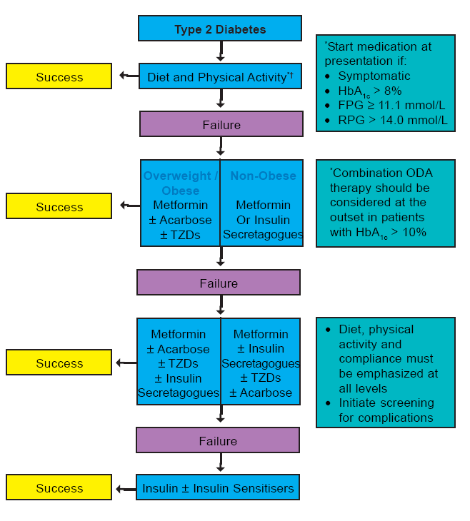
Diabetes Management Algorithm

Slide 80
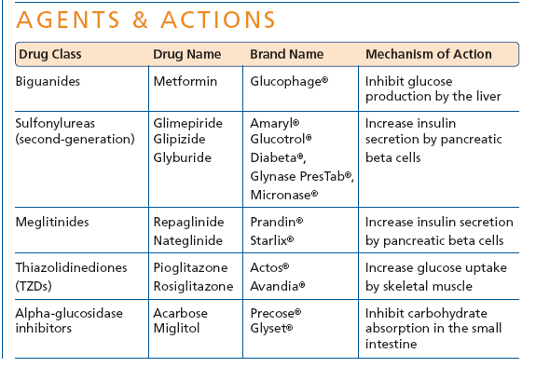
Oral Hypoglycaemic Medications

Slide 81
General Guidelines for Use of Oral Anti-Diabetic Agent inDiabetes
In elderly non-obese patients, short acting insulin secretagogues can be started but long acting Sulphonylureas are to be avoided. Renal function should be monitored.
Oral anti-diabetic agent s are not recommended for diabetes in pregnancy
Oral anti-diabetic agents are usually not the first line therapy in diabetes diagnosed during stress, such as infections. Insulin therapy is recommended for both the above
Targets for control are applicable for all age groups. However, in patients with co-morbidities, targets are individualized
When indicated, start with a minimal dose of oral anti-diabetic agent, while reemphasizing diet and physical activity. An appropriate duration of time (2-16 weeks depending on agents used) between increments should be given to allow achievement of steady state blood glucose control

Slide 82
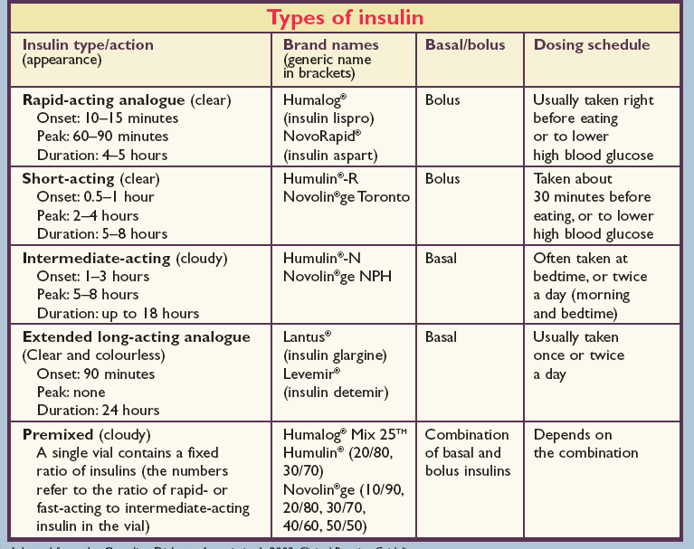

Slide 83
C. Insulin Therapy
Short-term use:
Acute illness, surgery, stress and emergencies
Pregnancy
Breast-feeding
Insulin may be used as initial therapy in type 2 diabetes
in marked hyperglycaemia
Severe metabolic decompensation (diabetic ketoacidosis, hyperosmolar nonketotic coma, lactic acidosis, severe hypertriglyceridaemia)
Long-term use:
If targets have not been reached after optimal dose of combination therapy or BIDS, consider change to multi-dose insulin therapy. When initiating this,insulin secretagogues should be stopped and insulin sensitisers e.g. Metformin or TZDs, can be continued.

Slide 84
Recommendations: Pharmacologic Therapy For Type 1 Diabetes
Most people with T1DM should be treated with multiple daily injections of prandial insulin and basal insulin or continuous subcutaneous insulin infusion (CSII). A
Individuals who have been successfully using CSII should have continued access after they turn 65 years old. E
American Diabetes Association Standards of Medical Care in Diabetes.
Approaches to glycemic treatment. Diabetes Care 2017; 40 (Suppl. 1): S64-S74
Notes:
Starting off with type 1 diabetes, there are plenty of other resources out there on initiating and managing insulin therapy, so we won’t go into that here.
Most of your patients with type 1 diabetes should be treated with multiple dose injections or insulin pump therapy. There are minimal differences between the two as far as hypoglycemia is concerned. Whichever one a patient chooses, intensive management and active patient or family participation should be strongly encouraged. [CLICK]
Individuals who have been successfully using an insulin pump should have continued access after they turn 65.
[SLIDE]
84
References
American Diabetes Association. Standards of medical care in diabetes—2014. Diabetes Care 2014;37(suppl 1):S26
The Diabetes Control and Complications Trial Research Group. The effect of intensive treatment of diabetes on the development and progression of long-term complications in insulin-dependent diabetes mellitus. N Engl J Med 1993;329:977–986
Nathan DM, Cleary PA, Backlund JY, et al for the Diabetes Control and Complications Trial/Epidemiology of Diabetes Interventions and Complications (DCCT/EDIC) Study Research Group. Intensive diabetes treatment and cardiovascular disease in patients with type 1 diabetes. N Engl J Med 2005;353:2643–2653

Slide 85
Recommendations: Pharmacological Therapy For Type 1 Diabetes (2)
Consider educating individuals with T1DM on matching prandial insulin dose to carbohydrate intake, premeal blood glucose, and anticipated activity. E
Most individuals with T1DM should use insulin analogs to reduce hypoglycemia risk. A
American Diabetes Association Standards of Medical Care in Diabetes.
Approaches to glycemic treatment. Diabetes Care 2017; 40 (Suppl. 1): S64-S74
Notes:
Consider educating your patients with type 1 diabetes on matching prandial insulin doses to carbohydrate intake, premeal blood glucose, and anticipated activity. [CLICK]
And finally, most individuals with type 1 should use insulin analogs to reduce the risk of hypoglycemia.
[SLIDE]
85

Slide 86
Recommendations: Pharmacologic Therapy For T2DM
Metformin, if not contraindicated and
if tolerated, is the preferred initial pharmacologic agent for T2DM. A
Consider insulin therapy (with or without additional agents) in patients with newly dx’d T2DM who are markedly symptomatic and/or have elevated blood glucose levels (>300 mg/dL) or A1C (>10%). E
American Diabetes Association Standards of Medical Care in Diabetes.
Approaches to glycemic treatment. Diabetes Care 2017; 40 (Suppl. 1): S64-S74
Notes:
Recommended pharmacological therapy for hyperglycemia in type 2 diabetes¹ is summarized on the next two slides.
First, metformin, if not contraindicated and if tolerated, is the preferred initial pharmacological agent for type 2 diabetes. Metformin has a long-standing evidence base for efficacy and safety, is inexpensive, and may reduce risk of cardiovascular events.
[CLICK]
In patients with newly diagnosed patients type 2 diabetes and markedly symptomatic or elevated blood glucose levels or A1C, consider insulin therapy, with or without additional agents, from the outset
[SLIDE]
86
References
American Diabetes Association. Standards of medical care in diabetes—2014. Diabetes Care 2014;37(suppl 1):S27
Inzucchi SE, Bergenstal RM, Buse JB, et al.; American Diabetes Association (ADA); European Association for the Study of Diabetes (EASD). Management of hyperglycemia in type 2 diabetes: a patient-centered approach. Position Statement of the American Diabetes Association (ADA) and the European Association for the Study of Diabetes (EASD). Diabetes Care 2012;35:1364–1379

Slide 87
New Recommendation: Pharmacologic Therapy For T2DM
Long-term use of metformin may be associated with biochemical vitamin B12 deficiency, and periodic measurement of vitamin B12 levels should be considered in metformin-treated patients, especially in those with anemia or peripheral neuropathy. B
American Diabetes Association Standards of Medical Care in Diabetes.
Approaches to glycemic treatment. Diabetes Care 2017; 40 (Suppl. 1): S64-S74
Notes:
To reflect new evidence showing an association between B12 deficiency and longterm metformin use, a recommendation was in 2017 added to consider periodic measurement of B12 levels and supplementation as needed.
[SLIDE]
87
References
American Diabetes Association. Standards of medical care in diabetes—2014. Diabetes Care 2014;37(suppl 1):S27
Inzucchi SE, Bergenstal RM, Buse JB, et al.; American Diabetes Association (ADA); European Association for the Study of Diabetes (EASD). Management of hyperglycemia in type 2 diabetes: a patient-centered approach. Position Statement of the American Diabetes Association (ADA) and the European Association for the Study of Diabetes (EASD). Diabetes Care 2012;35:1364–1379

Slide 88
Recommendations: Pharmacological Therapy For T2DM
If noninsulin monotherapy at maximal tolerated dose does not achieve or maintain the A1C target over 3 months, add a second oral agent, a GLP-1 receptor agonist, or basal insulin. A
Use a patient-centered approach to guide choice of pharmacologic agents. E
Don’t delay insulin initiation in patients not achieving glycemic goals. B
American Diabetes Association Standards of Medical Care in Diabetes.
Approaches to glycemic treatment. Diabetes Care 2017; 40 (Suppl. 1): S64-S74
Notes:
If noninsulin monotherapy at maximal tolerated dose does not achieve or maintain the A1C target over 3 months, add a second oral agent, a glucagon-like peptide 1 (GLP-1) receptor agonist, or insulin [CLICK]
A patient centered approach should be used to guide the choice of pharmacological agents. Considerations include efficacy, cost, potential side effects, weight, comorbidities, hypoglycemia risk, and patient preference. [CLICK]
And finally, for patients with type 2 diabetes who are not achieving glycemic goals, insulin therapy should not be delayed.
[SLIDE]
88
References
American Diabetes Association. Standards of medical care in diabetes—2014. Diabetes Care 2014;37(suppl 1):S27
Holman RR, Paul SK, Bethel MA,Matthews DR, Neil HA. 10-year follow-up of intensive glucose control in type 2 diabetes. N Engl J Med 2008;359:1577–1589
Bennett WL, Maruthur NM, Singh S, et al. Comparative effectiveness and safety of medications for type 2 diabetes: an update including new drugs and 2-drug combinations. Ann Intern Med 2011;154:602–613

Slide 89
Notes:
[note to speaker – use either this slide or the previous slide depending on the audience and format of your talk]
Here is an overview of the ADA’s treatment algorithm for type 2 diabetes, moving from monotherapy, to duel therapy, to triple therapy, and then to combination injectable therapy. Lifestyle management is emphasized throughout the progression of care, and individualization based on efficacy, hypoglycemia risk, weight, side effects, and costs is recommended.
It is important to note that the ADA’s full Standards of Care provides tables on the properties of these agents, as well as the costs associated with them. Please visit professional-dot-diabetes-org-slash-S-O-C for more information.
The order in the chart was determined by historical availability and the route of administration, with injectables to the right; it is not meant to denote any specific preference. Potential sequences of antihyperglycemic therapy for patients with type 2 diabetes are displayed, with the usual transition moving vertically from top to bottom (although horizontal movement within therapy stages is also possible, depending on the circumstances). DPP-4-i, DPP-4 inhibitor; fxs, fractures; GI, gastrointestinal; GLP-1 RA, GLP-1 receptor agonist; GU, genitourinary; HF, heart failure; Hypo, hypoglycemia; SGLT2-i, SGLT2 inhibitor; SU, sulfonylurea; TZD, thiazolidinedione.
[SLIDE]
89

Slide 90
Notes:
[note to speaker – use either this slide or the previous slide depending on the audience and format of your talk]
The algorithm for combination injectable therapy in type 2 diabetes starts with basal insulin, with or without other agents, and offers three equivalent strategies for intensification if goals are not met, with ample room for individualization.
Again, it is important to note that the ADA’s full Standards of Care provides tables on the properties of these agents, as well as the costs associated with them. Please visit professional-dot-diabetes-org-slash-S-O-C for more information.
FBG, fasting blood glucose; GLP-1 RA, GLP-1 receptor agonist; hypo, hypoglycemia.
[SLIDE]
90

Slide 91
Recommendations: Hypertension/ Blood Pressure Treatment (3)
Treatment for hypertension should include A
  ACE inhibitor
  Angiotensin II receptor blocker (ARB)
  Thiazide-like diuretic
  Dihydropyridine calcium channel blockers
Multiple drug therapy (two or more agents at
maximal doses) generally required to achieve BP
targets.
American Diabetes Association Standards of Medical Care in Diabetes.
Cardiovascular disease and risk management. Diabetes Care 2017; 40 (Suppl. 1): S75-S87
Notes:
Pharmacologic therapy for patients with diabetes and hypertension should include drug classes demonstrated to reduce cardiovascular events in patients with diabetes, shown here. Multiple drug therapy (two or more agents at maximal doses) is generally required to achieve blood pressure targets, but not a combination of ACE inhibitors and ARBs.
[SLIDE]
91
Reference
American Diabetes Association. Standards of medical care in diabetes—2014. Diabetes Care 2014;37(suppl 1):S36

Slide 92
Recommendations: Hypertension/ Blood Pressure Treatment (4)
An ACE inhibitor or angiotensin receptor blocker, at the maximum tolerated dose indicated for blood pressure treatment, is the recommended first-line treatment for hypertension in patients with diabetes and urinary albumin–to– creatinine ratio >300 mg/g creatinine (A) or 30–299 mg/g creatinine (B). If one class is not tolerated, the other should be substituted. B
American Diabetes Association Standards of Medical Care in Diabetes.
Cardiovascular disease and risk management. Diabetes Care 2017; 40 (Suppl. 1): S75-S87
Notes:
In patients with both hypertension and albuminuria, blood pressure treatment should include either an ACE inhibitor or ARB.
[SLIDE]
92
Reference
American Diabetes Association. Standards of medical care in diabetes—2014. Diabetes Care 2014;37(suppl 1):S36

Slide 93

THANK YOU

Slide 94


